Slide 1
Govern data across an enterprise
Notes:
Before delivering this presentation, review the associated modules on Microsoft Learn (https://aka.ms/mslearn-purview) and complete the exercises.
Before starting your delivery, prepare a lab environment for the first demonstration by running the setup script.

Slide 2


Agenda
Introduction to Microsoft Purview
Integrate Microsoft Purview and Azure Synapse Analytics
Notes:
There are no hands-on labs associated with this slide deck – Govern data across an enterprise.

Slide 3
Introduction to Microsoft Purview

Slide 4
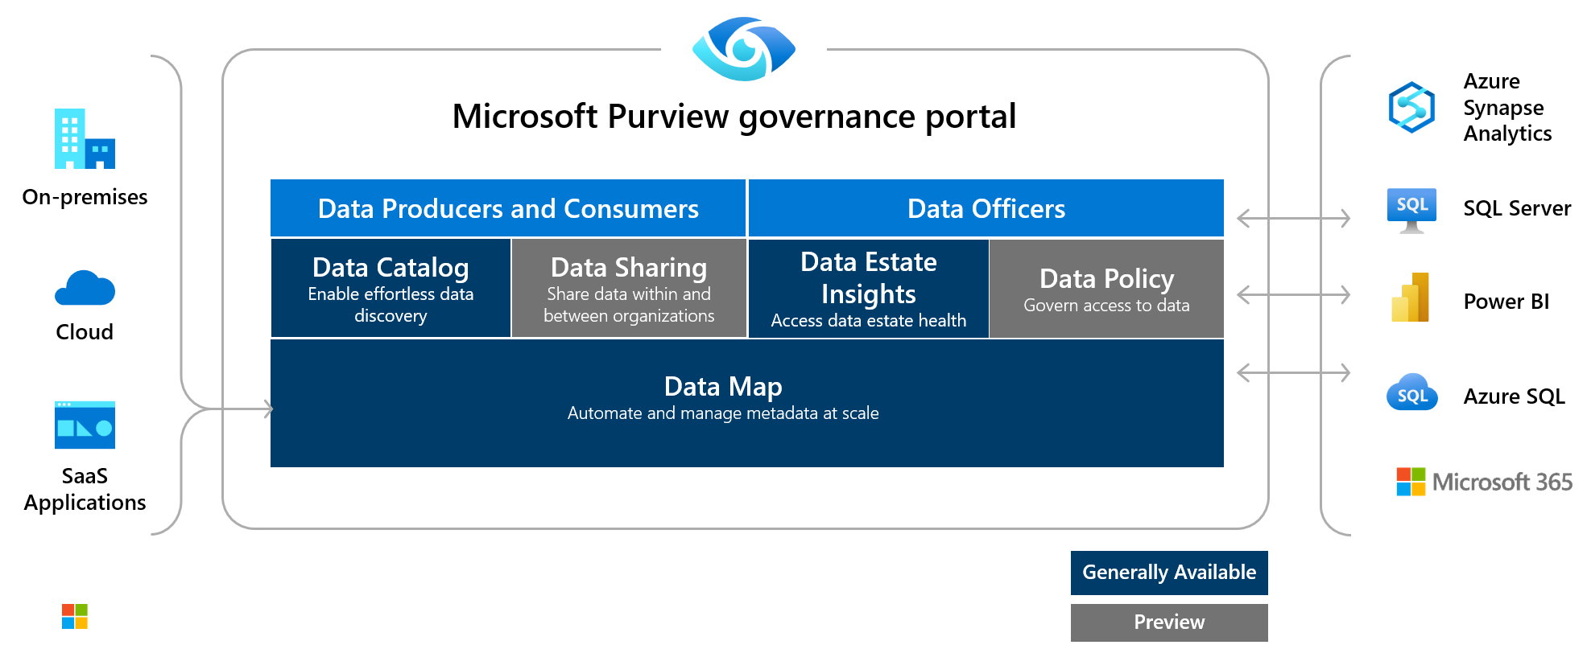
What is Microsoft Purview?
Notes:
Microsoft Purview is a unified data governance service that helps you manage and govern your on-premises, multi-cloud, and software-as-a-service (SaaS) data. Easily create a holistic, up-to-date map of your data landscape with automated data discovery, sensitive data classification, and end-to-end data lineage. Empower data consumers to find valuable, trustworthy data.
The Microsoft Purview governance portal allows you to:
Create a holistic, up-to-date map of your data landscape with automated data discovery, sensitive data classification, and end-to-end data lineage.
Enable data curators to manage and secure your data estate.
Empower data consumers to find valuable, trustworthy data.
The main elements are the Microsoft Purview Data Map, Purview Data Catalog, and Purview Data Estate Insights. Microsoft Purview Data Map powers the Purview Data Catalog and Purview Data Estate Insights as unified experiences within the Microsoft Purview governance portal.

Slide 5



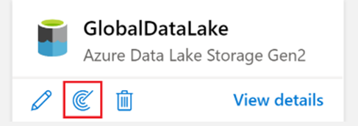
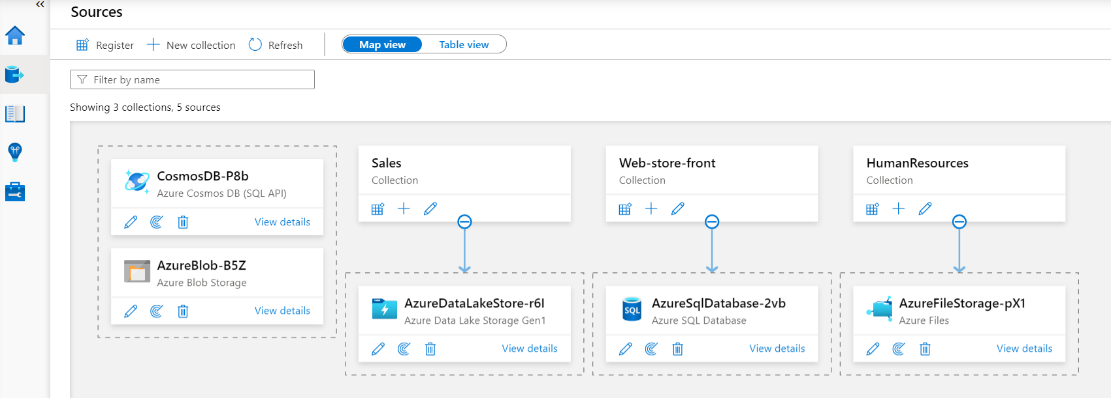

How Microsoft Purview works (1/2)
Register sources
Scan and classify
View Data Map
Notes:
The core operational theory:
1) Load data in the Data Map
Register and scan data sources at collection level. Use out-of-the-box or custom scan rules.
View in Data Map
2) Browse and search information
Before you can register and scan data, it’s important to understand the concept of collections. In Microsoft Purview Data Catalog, collections are key concept because they drive permissions and asset protection. Collections are also used to understand data estate health and catalog usage and adoption.
To hydrate the data map, you need to register and scan your data sources, which is done at the collection level. Collections support organizational mapping of metadata. By using collections, you can manage and maintain data sources, scans, and assets in a hierarchy instead of a flat structure.
Data sources are registered and scanned in the Purview governance portal
Each data source will have specific requirements for authenticating and configuration, to permit scanning of the assets in that data source.
Metadata is used to help classify the data that is being scanned and made available in the catalog. The classification rules fall under 5 major categories:
Government - covers attributes such as government identity cards, driver license numbers, passport numbers, etc.
Financial - covers attributes such as bank account numbers or credit card numbers.
Personal - personal information such as a person's age, date of birth, email address, phone number, etc.
Security - attributes like passwords that may be stored.
Miscellaneous - attributes not covered in the other categories.
After registering sources, you’ll organize them into Collections. Collections are a way of grouping data assets into logical collections, to simplify management and discovery of assets within the catalog.
Collections can then be viewed in the data map.

Slide 6
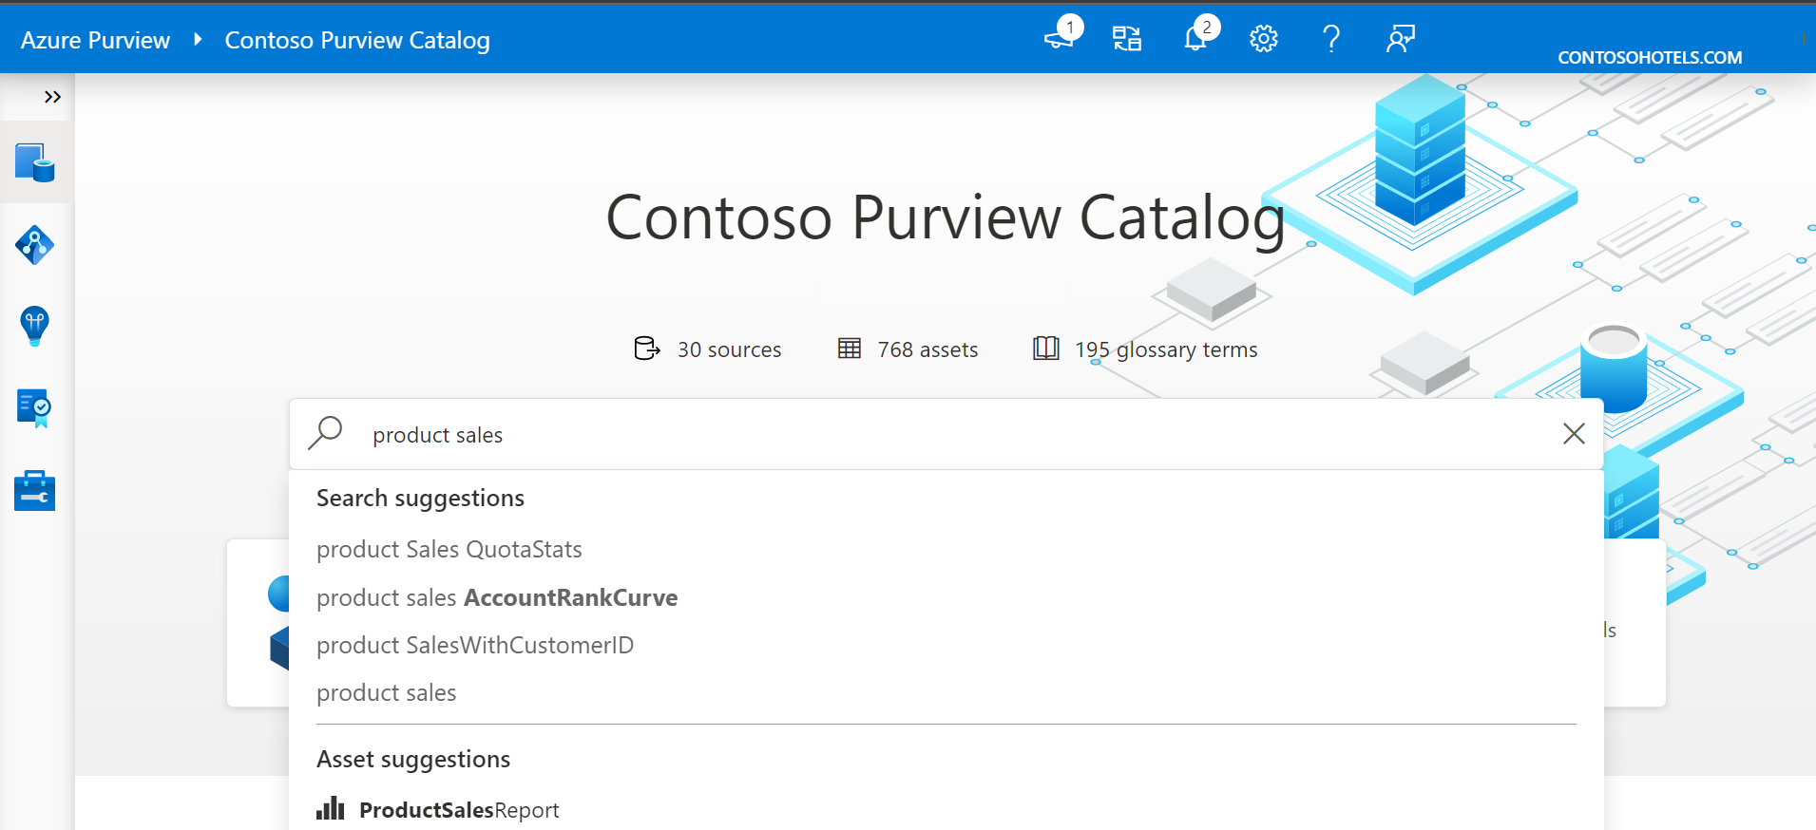
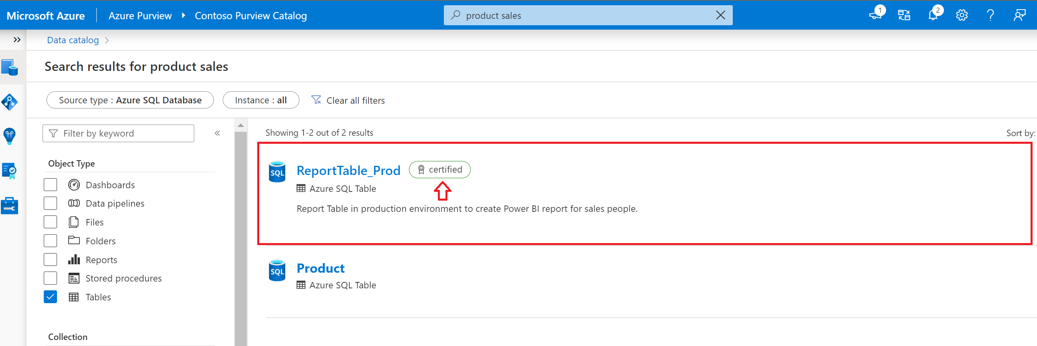
How Microsoft Purview works (2/2)
Search for product sales
Search results
Notes:
This is a build slide.
Microsoft Purview allows you to search information from Data Map using Purview Catalog. You can perform text-based search and incorporate business context into the search as well.
Enable data discovery with:
Semantic search and browse
Business glossary and workflows
Data lineage with sources, owners, transformations, and lifecycle

Slide 7
When to use Microsoft Purview
Criteria that indicate whether Microsoft Purview will meet your requirements:
Decision criteria
Discovery:
Because there's no central location to register data sources, users might be unaware of a data source unless they come into contact with it as part of another process.
Governance:
Compliance with company security policies, government regulations, and customer needs, are critical considerations for data governance.
Notes:
Consider the two cases on the slide – they represent scenarios in which Microsoft Purview may be a useful solution.

Slide 8

Knowledge check
What does Microsoft Purview do with the data it discovers from your registered sources?
It catalogs and classifies the data that is scanned.
It moves the data to your Azure subscription, automatically creating the necessary storage accounts
It performs data transformations to match your on-premises schemas
What aspect of Microsoft Purview is used to configure the data discovery for your data sources?
Scan rules
Collections
Classifications
Notes:
Allow students a few minutes to think about the questions, and then use the animated slide to reveal the correct answers.

Slide 9
Integrate Microsoft Purview and Azure Synapse Analytics

Slide 10
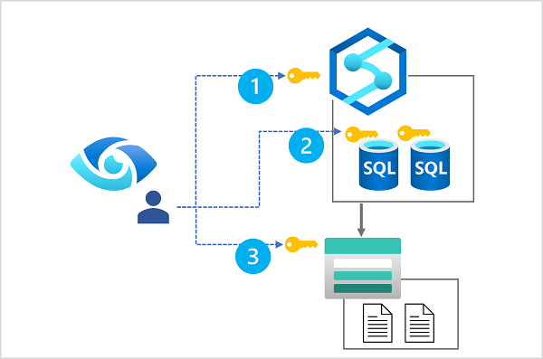
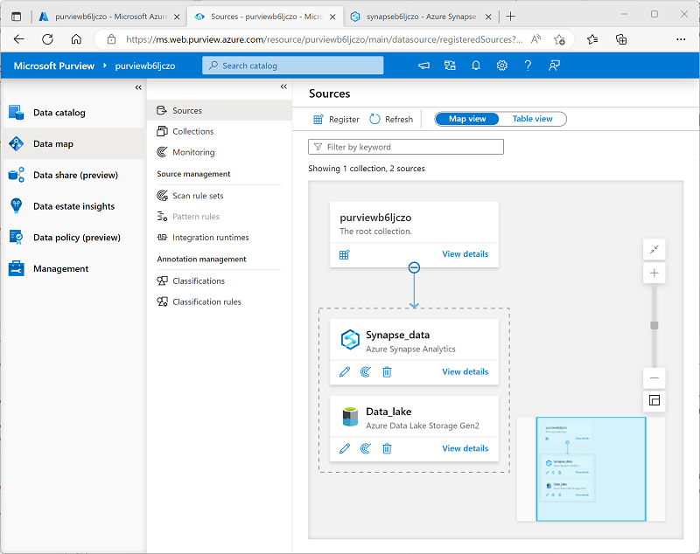
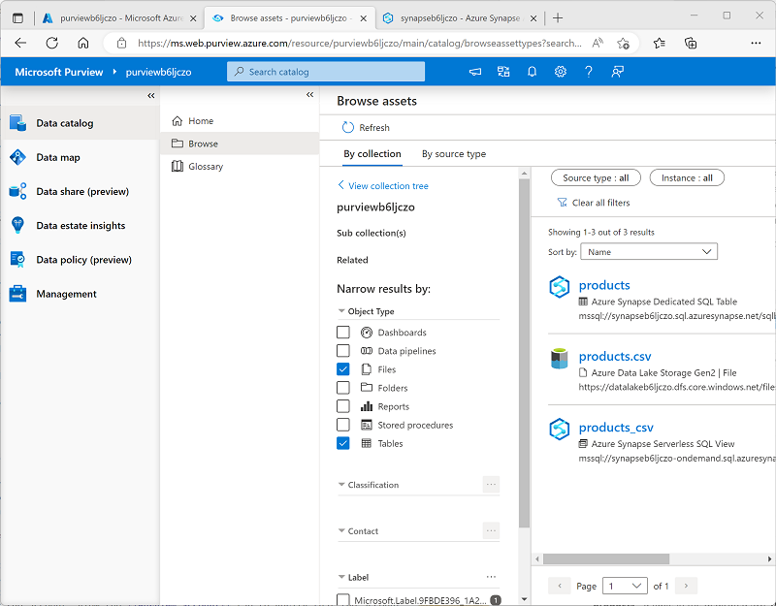
Catalog Azure Synapse Analytics data assets in Microsoft Purview
Configure data access for Microsoft Purview
Read access to the Azure Synapse workspace
Read access to each SQL database that will be scanned
Read access to data lake storage
Register and scan data sources
Add each source to a collection
Create and run a scan for each source
View and manage cataloged data assets
Browse the data catalog
Filter to find specific asset types
Notes:
Use the slide to describe a high-level process (left to right) for using Microsoft Purview to catalog data assets in Azure Synapse Analytics to that data engineers, analysts, and scientists can find sources of data in the Azure Synapse Analytics workspace; including:
Files in data lake storage
Tables in dedicated SQL pools (data warehouses)
External tables and views in serverless SQL pools
Students will get a chance to go through this process in the lab.

Slide 11
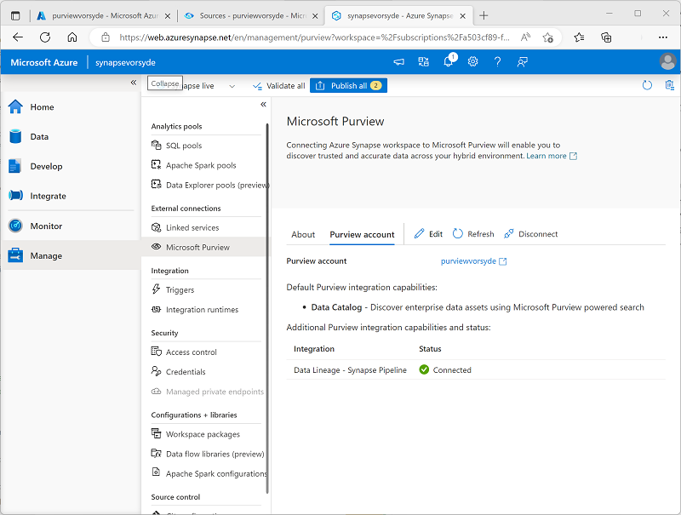
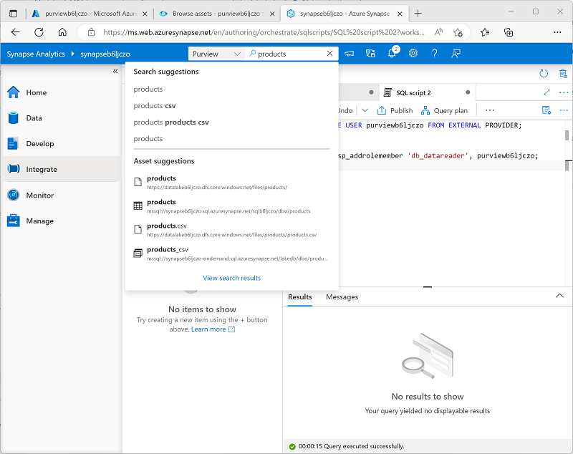
Search data catalogs from Azure Synapse Studio
Connect a Microsoft Purview account to a Synapse Analytics workspace
Search Microsoft Purview in Synapse Studio
Notes:
Again, the slide shows a high-level process – this time for making the Microsoft Purview data asset catalog searchable from Azure Synapse Studio (so data engineers, analysts, and scientists can find sources of data throughout the enterprise). Again students will do this in the lab.

Slide 12
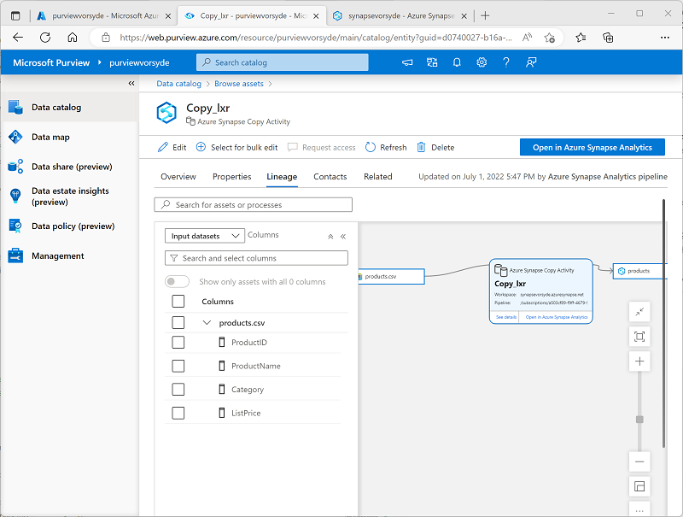
Track data lineage in pipelines
Generate and view data lineage information:
In Azure Synapse Analytics, data movement and transformation is managed by using pipelines, which consist of an orchestrated set of activities that operate on data
In the Microsoft Purview Governance Portal, you can open the assets in the Microsoft Purview catalog, and view the linage information
Notes:
Data lineage is a critical element of a data governance solution, and lineage tracking may be required for auditing and compliance purposes.

Slide 13

Exercise: Integrate Azure Synapse Analytics and Microsoft Purview
Use the hosted lab environment provided, or view the lab instructions at the link below:
https://aka.ms/mslearn-synapse-purview
Notes:
The exercise will take a minimum of 40 minutes to complete, including 5-10 minutes at the start to set up the environment.
Not all students work at the same pace, so you should allow an hour or more as necessary for your class.

Slide 14
Knowledge check
You want to scan data assets in a dedicated SQL pool in your Azure Synapse Analytics workspace. What kind of source should you register in Microsoft Purview?
Azure Synapse Analytics
Azure Data Lake Storage Gen2
Azure SQL Database
You want to scan data assets in the default data lake used by your Azure Synapse Analytics workspace. What kind of source should you register in Microsoft Purview?
Azure Synapse Analytics
Azure Data Lake Storage Gen2
Azure Cosmos DB
You want data analysts using Synapse Studio to be able to find data assets that are registered in a Microsoft Purview collection. What should you do?
Register an Azure Synapse Analytics source in the Purview account
Add a Data Explorer pool to the Synapse Workspace
Connect the Purview account to the Synapse analytics workspace
Notes:
Allow students a few minutes to think about the questions, and then use the animated slide to reveal the correct answers.

Slide 15

Further reading
Govern data across an enterprise
https://aka.ms/mslearn-purview
Notes:
Encourage students to review the online material on Microsoft Learn on which this presentation is based.

